Slide 1

RUMYPET(R U my pet?)
Team Groza
Kim Tae Hong (20132335)
Kim Chan Il (20150577)
(Presenter) Paeng Jin Wook (20154645)
Notes:
Hello everyone, we’re team Groza.
I’m a presenter 팽진욱

Slide 2
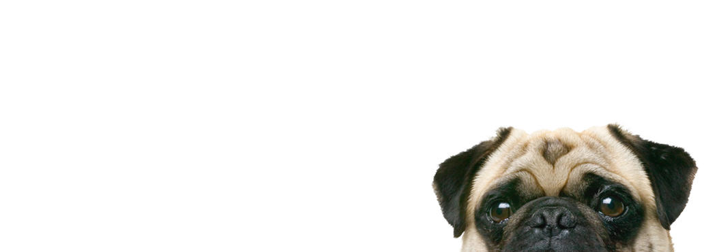
Contents
Schedule & Progress
Problems & Solutions
Plans
Q&A

Slide 3
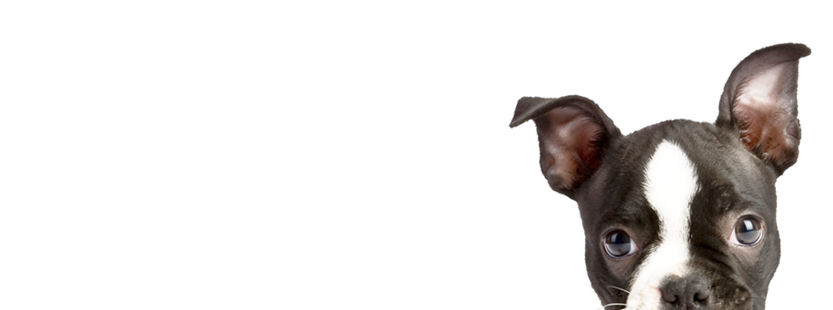
1. SCHEDULE & PROGRESS

Slide 4
SCHEDULE
Week |  | To-Do (can be changed)
Week 9 |  | Hold a meeting and make a Plan based on Midterm Demonstration.
Week 10 |  | Android : Image Upload Function. Server : Add a image data column in database and link with python code. Python : Link to the server
Week 11 |  | Android : E-mail Certification function. Server : link to python code completely and buy a server. Python : Find the way to save the feature template in database.
Week 12 |  | Android : Complete the detail function. (Edit Profile, etc...) Server : Divide the mode of the function in server. Python : Code refactoring and enhance the performance.
Week 13 |  | Android : Debugging and error fixing. Server : move the data to the database that we bought, and refactor. Python : Code refactoring and enhance the performance.
Week 14 |  | Android : Release the Beta Version and unit testing by users. Server : Error fixing, and managing the server. Python : Code refactoring and enhance the performance.
Week 15 |  | Final Demonstration
Week 16 |  | Final Examination
4
Notes:
This is the schedule later.

Slide 5
Role of this week
Week 9 | Hold a meeting and make a Plan based on Midterm Demonstration.
5

Slide 6


Schedule & Progress – Kim Chan Il (Android)
“Complete the Android Application in detail”
6
Notes:
This is the UI Deisign we did last week.
Using this, Chan il Kim applied this into Android Studio.

Slide 7
Schedule & Progress – Kim Chan Il (Android)
“Certification in Registering by E-mail & Phone number”
Certificate Complete!
010-xxxx-xxxx
xxxx@mail.com
7
Notes:
This is the UI Deisign we did last week.
Using this, Chan il Kim applied this into Android Studio.

Slide 8

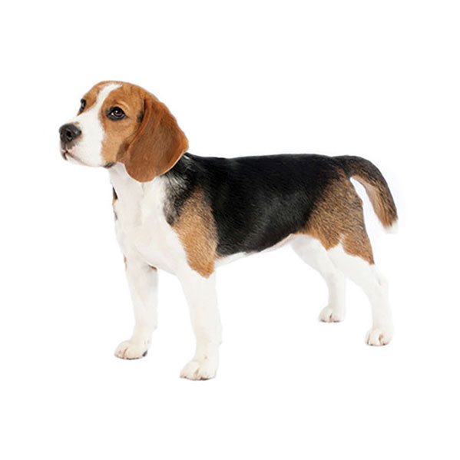
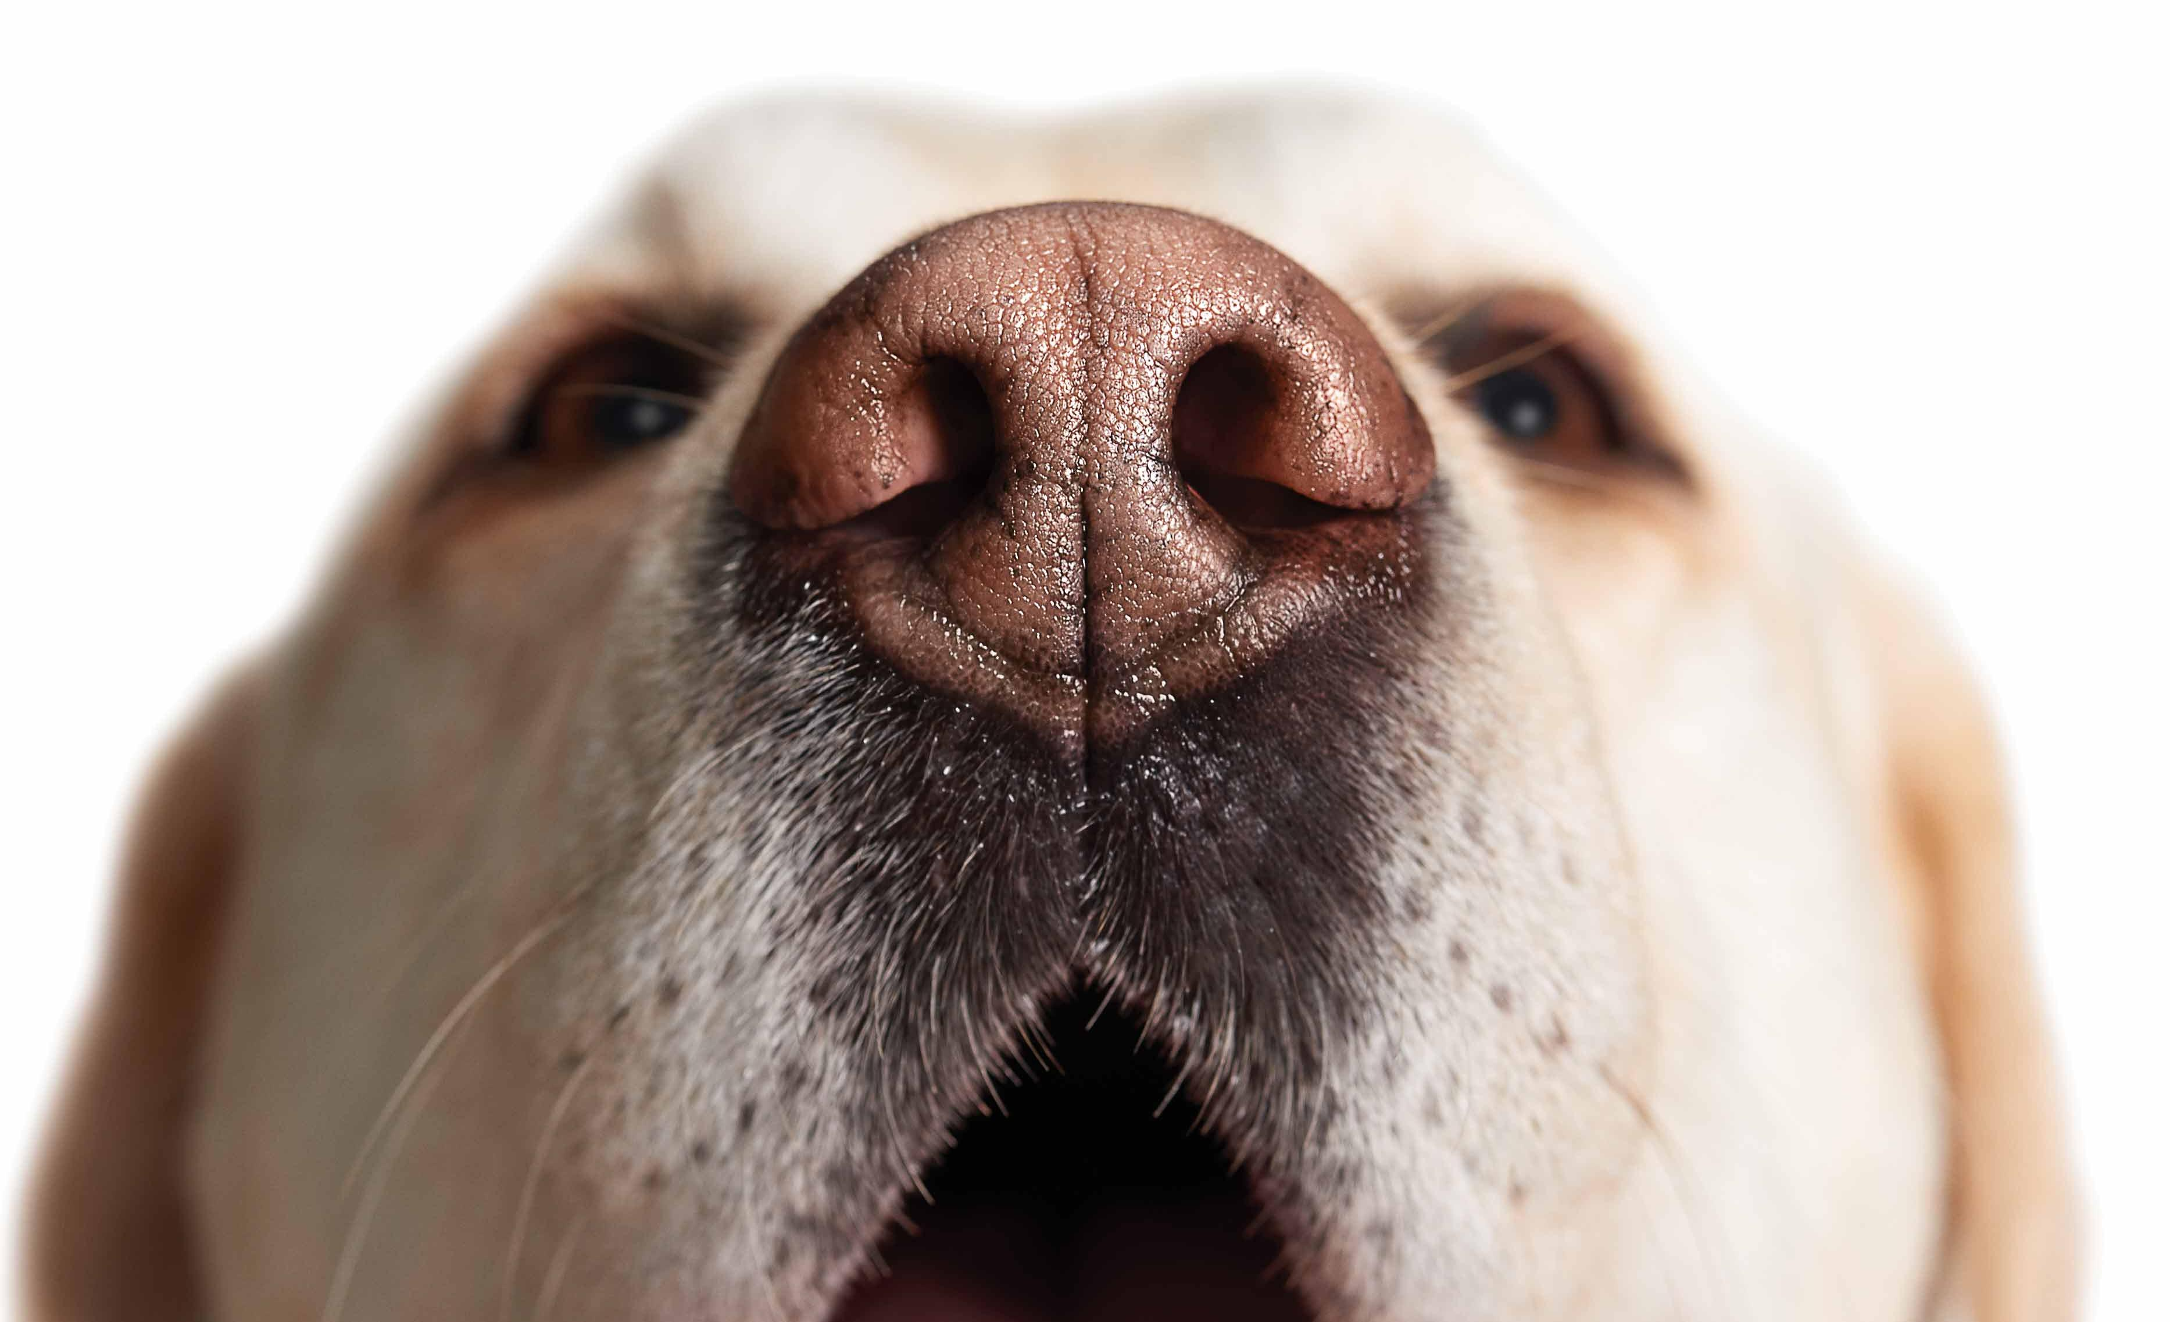



Schedule & Progress – Kim Chan Il (Android)
“Uploading Dog Image and Dog’s nose Image in Database”
“Make Candidate of the dog when finding a dog”
8
Notes:
This is the UI Deisign we did last week.
Using this, Chan il Kim applied this into Android Studio.

Slide 9

Schedule & Progress – Kim Tae Hong (Server)
“We will buy a Server because we need a big database to contain many datas”
9
Notes:
Left one is the simple python code for testing
Right one is the return value that came from the python code. We get the string through the server using nodejs.

Slide 10
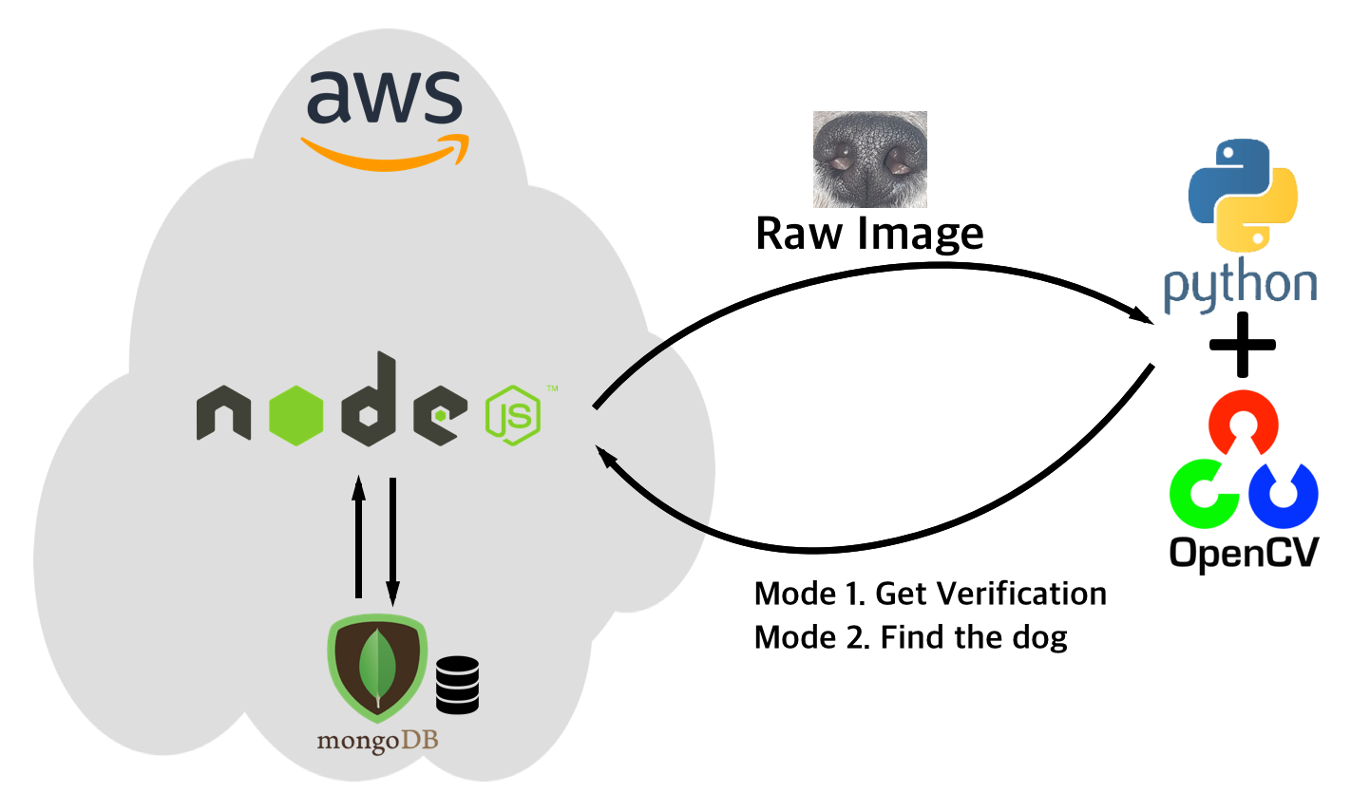
Schedule & Progress – Kim Tae Hong (Server)
“Connecting the Python Code with the server. Make it work!”
10
Notes:
Left one is the simple python code for testing
Right one is the return value that came from the python code. We get the string through the server using nodejs.

Slide 11
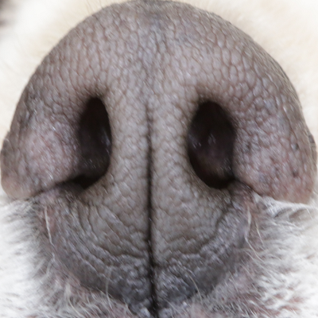
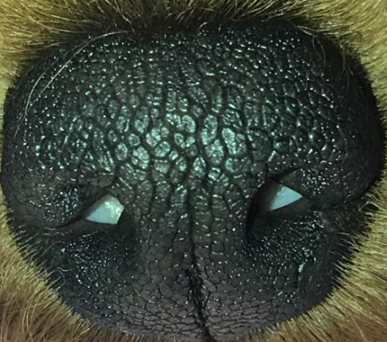
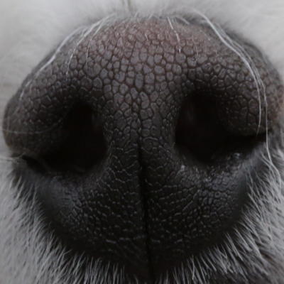
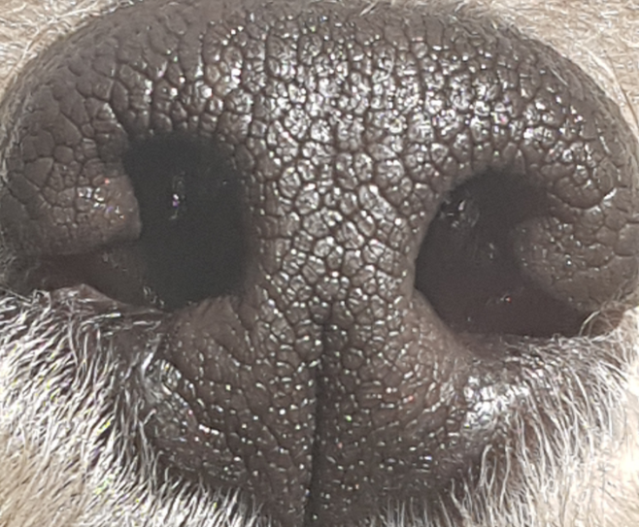
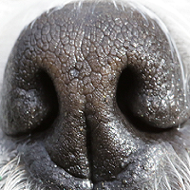
Schedule & Progress – Paeng Jin Wook (Python)
“Get much more data for testing and accurate performance”
11

Slide 12


Schedule & Progress – Paeng Jin Wook (Python)
“Fix the algorithm of Pre-processing and Matching process
to get a good performance”
12

Slide 13

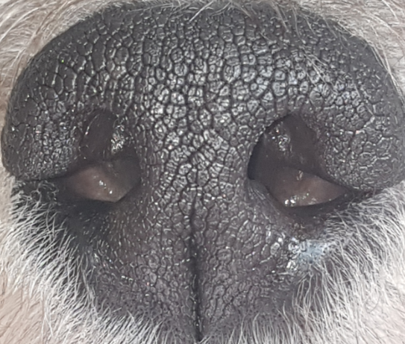
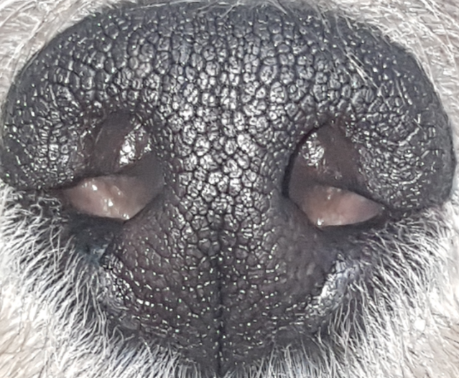


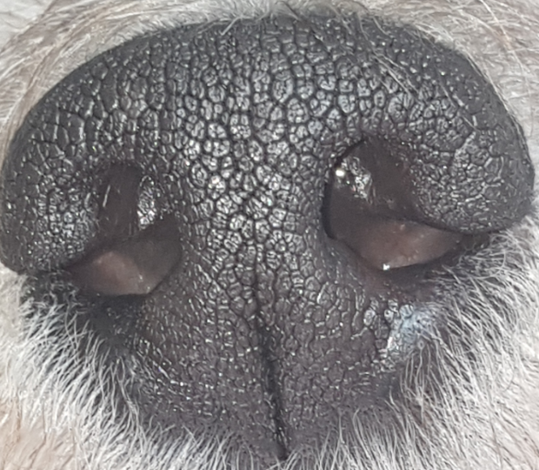
Schedule & Progress – Paeng Jin Wook (Python)
“Complete the Verification Mode Using many datas”
“Connect with Android Application and Make it work!”
· Mode 1 : Verification
Database
Input Image
(Dog A)
The image is Dog A
(Correct!)
Dog A Datas
13
Notes:
As I said, Python code is not connected to the server yet.
So we assumed that python code is connected to the server and then developed the process.
Mode 1 is verification. Same Principle with certifying myself with my fingerprint.

Slide 14
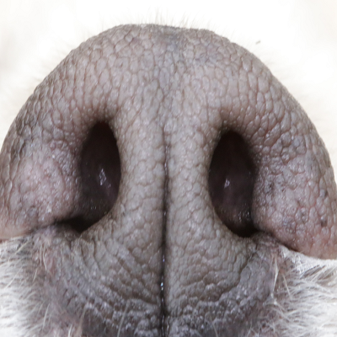
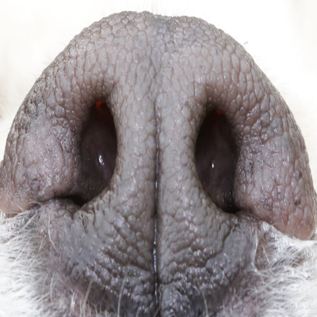
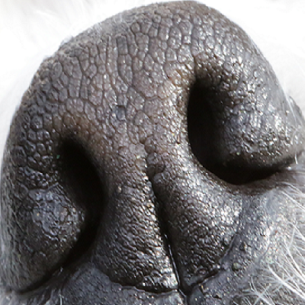
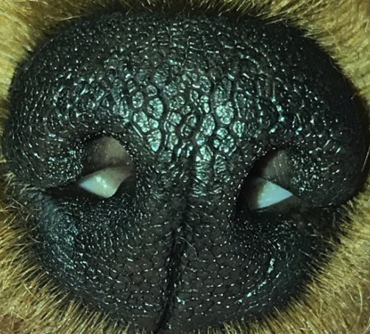
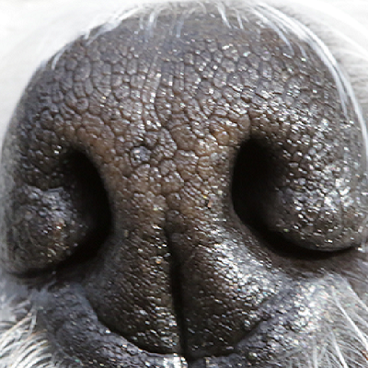
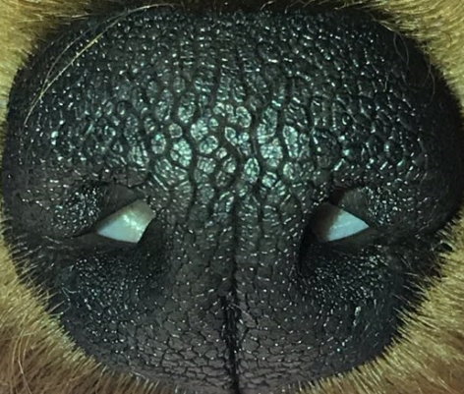

Schedule & Progress – Paeng Jin Wook (Python)
“We need to decrease the performance time ”
· Mode 2 : Identification
Database
Input Image
(Whose dog it is?)
The image is Dog A
Datas
14
Notes:
Mode 2 is identification. This is for searching whose dog it is.
We firstly give attention to develop the Mode 1 first.

Slide 15
2. PROBLEMS & SOLUTION

Slide 16
PROBLEMS & SOLUTIONS
Problem 1
We will get so much time in Mode2.
When we compare all the data to find the unknown dog’s information.
Input Image
Database
(Whose dog it is?)
16
Notes:
--ppt reading--
Now, we have our own server!

Slide 17
PROBLEMS & SOLUTIONS
Solution 1
We have to find the way to save the data by feature template, Not by nose image
Feature
Template
Input Image
Database
(Whose dog it is?)
17
Notes:
--ppt reading--
Now, we have our own server!

Slide 18
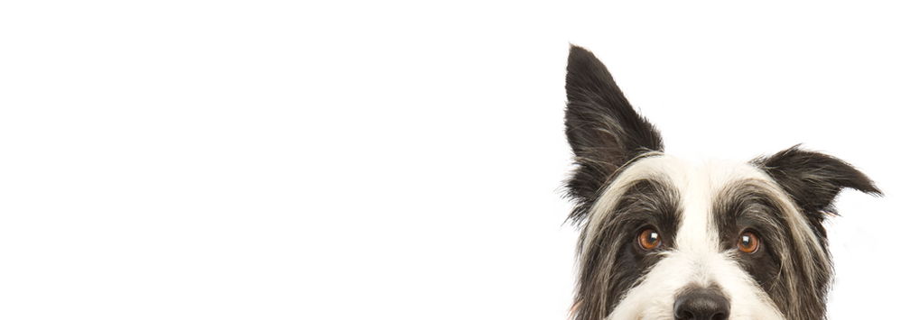
3. PLANS

Slide 19
PLANS for next week
Week 10 | Chan: Image Upload Function. Hong : Add a image data column in database and link with python code. Paeng : Link with the server
19
Notes:
ppt reading

Slide 20
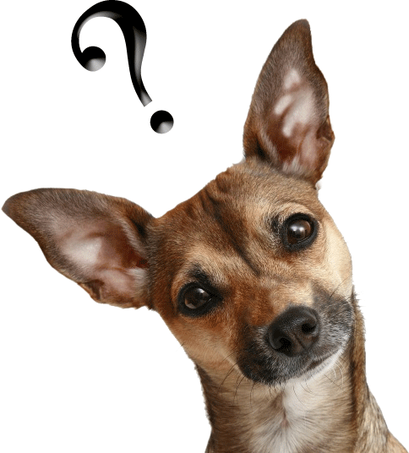
Q&A

Slide 21
Thank you!

